Slide 1
HR Attrition Analysis
Auto-generated deck — adjust narrative manually

Slide 2
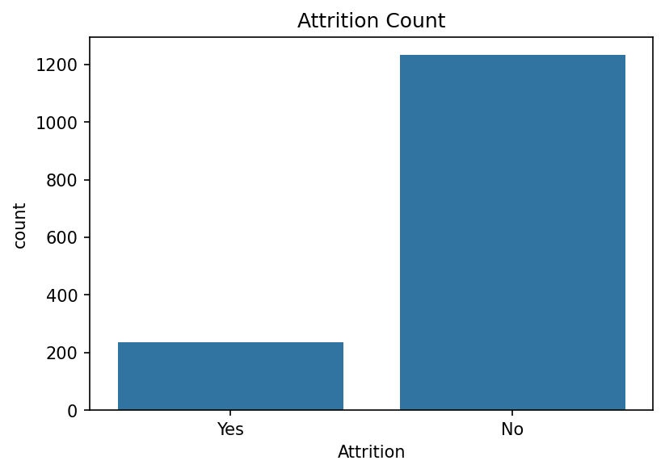
Attrition distribution

Slide 3
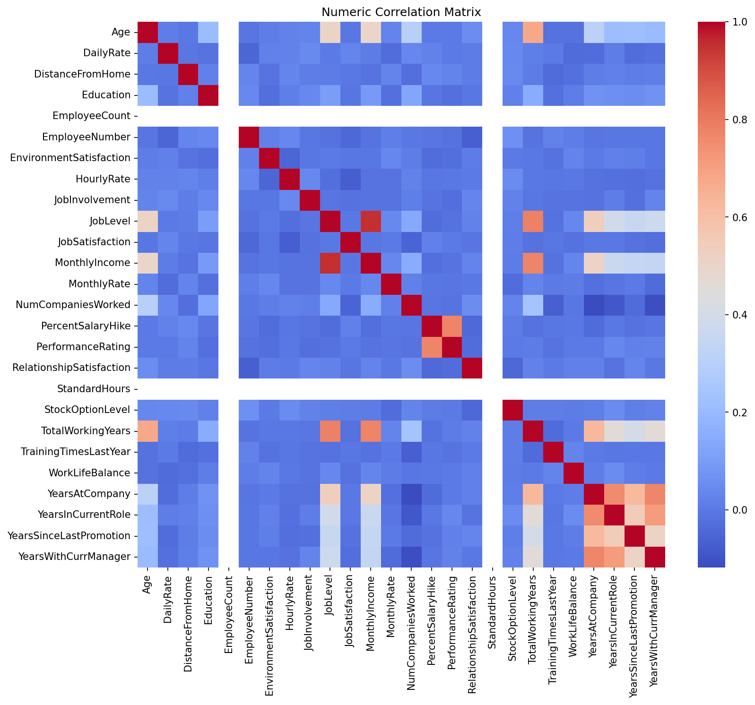
Correlation matrix

Slide 4
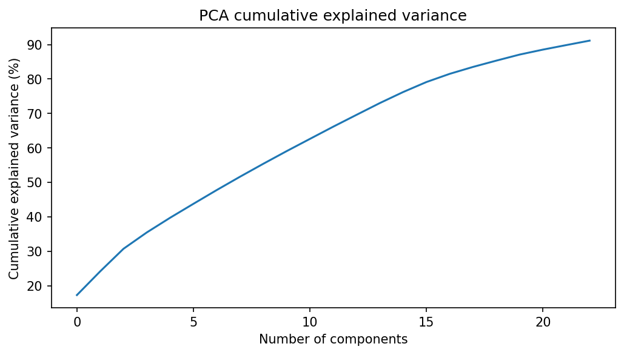
PCA explained variance

Slide 5
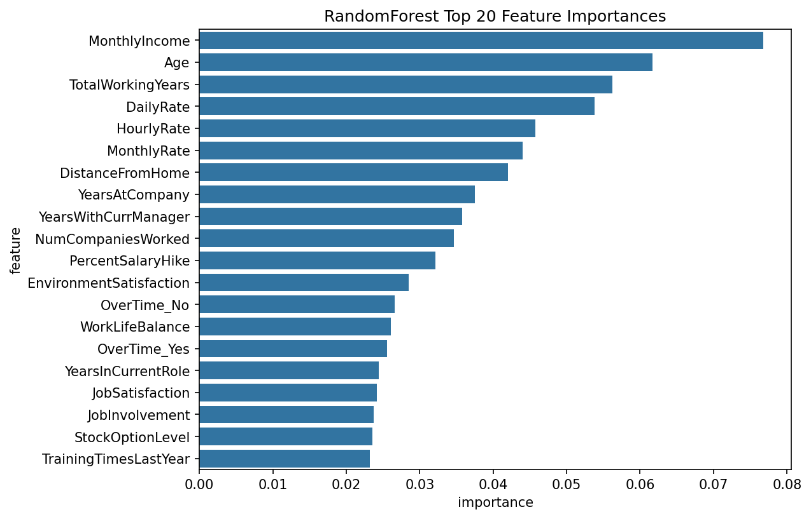
RF top features

Slide 6
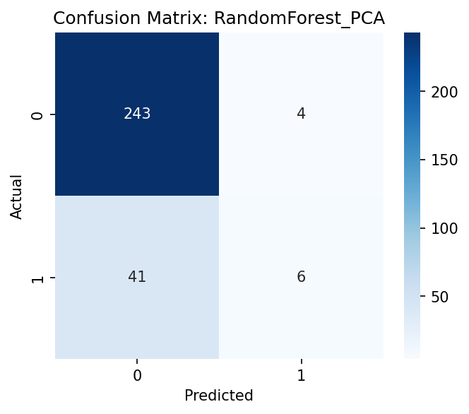
Confusion Matrix (best model)

